Slide 1
VW Meetup | November 28, 2019
HBase - Practitioner’s Guide
Adam Szorcz - adam.szorcz@roche.com

Slide 2
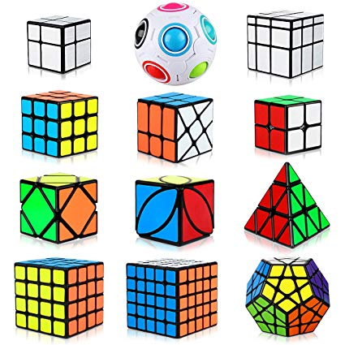



Adam Szorcz
Big Data expert at Roche
Rubiks cubes
Books
Programming
Psychology
Quantum Physics
Jokes
Trivias
first work: sawmill

Slide 3
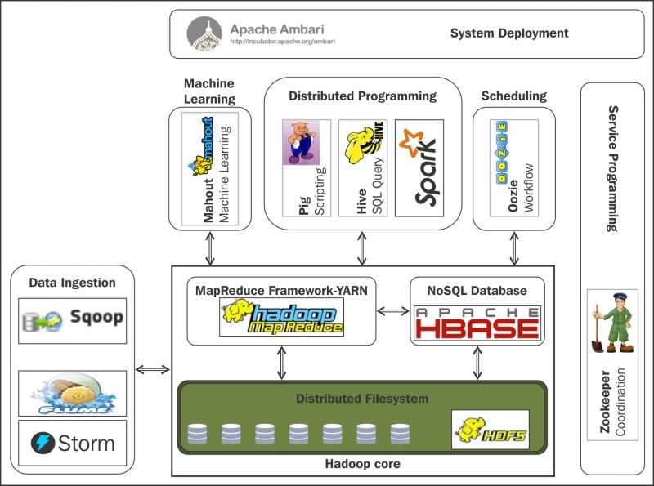
HBase as part of Hadoop ecosystem
HBase has been developed as part of Hadoop
It is based on HDFS (Hadoop Distributed File System)
NoSQL, Columnar Database (?)
Software installed on computers in cluster

Slide 4
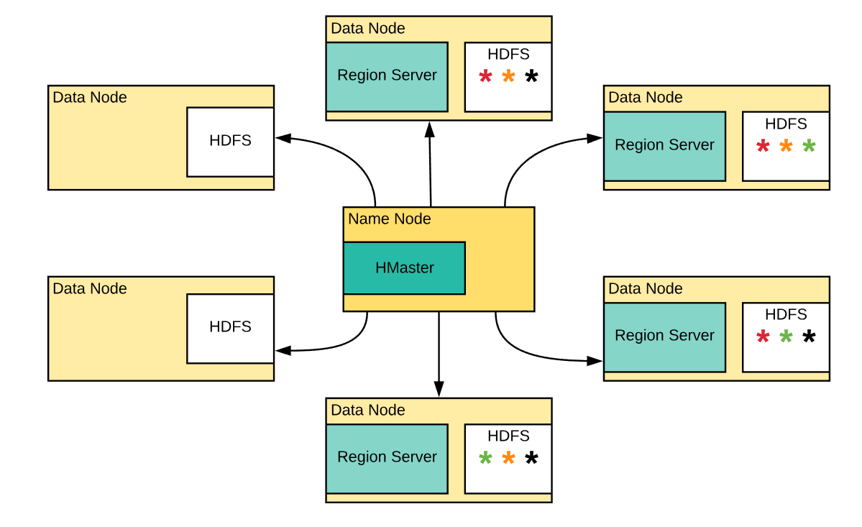
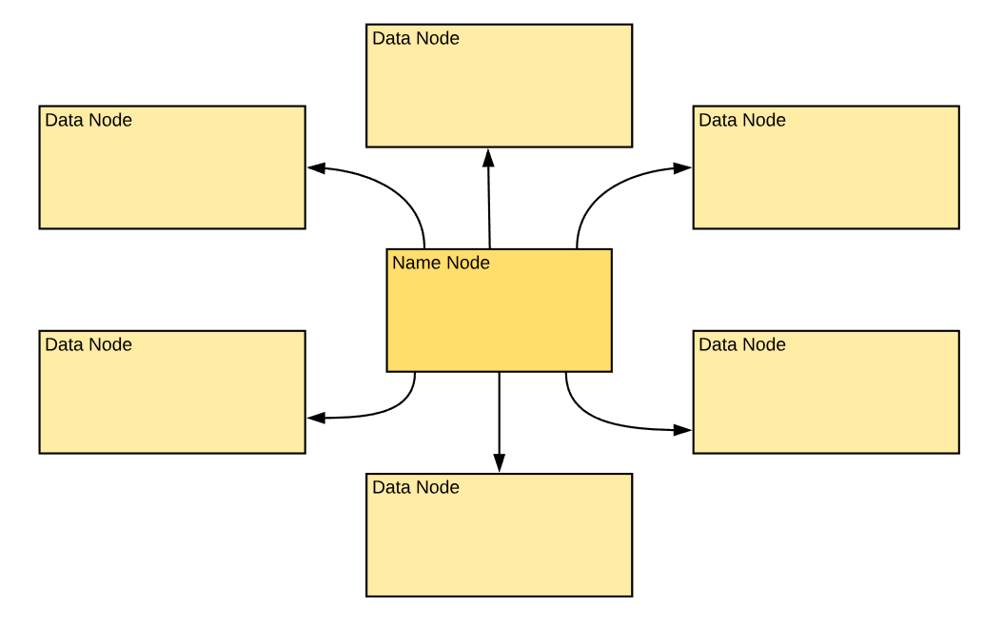
HBase - distributed architecture
Data of HBase is stored on HDFS
Replication is managed by the HDFS
HMaster is usually installed on NameNode
Region Servers are usually installed on Data Nodes
SPoF resistant

Slide 5
Structure Definition
HBase
namespace
table
column family
namespace: myNS
table myNS:myTable
column family a
column family b
column family c
Notes:
namespace, table, column family, columns

Slide 6
Data Structure
row is idetified by rowkey
rows are sorted by the rowkeys
in each column family row may have any number of cells with any set of distinct qualifiers and value
both cq and value can be any byte array
column cannot have NULL as value or qualifier
table myNS:myTable
rowkeys are sorted
column family a
column family b
column family c
rowkey a7dkegh79
rowkey c382374
rowkey z48hdsh65
Cell is defined by: tablename, rowkey, column family and column qualifier
Example: myNS:myTable, a7dkegh79, a:myColumn

Slide 7
Security Levels
grant ‘{who}’, ‘{rights}’, ‘{scope}’
{who}
user, group
{rights}
R(ead), W(rite), C(reate), A(dmin)
{scope}
namespace, table, column family, column qualifier
HBase
namespace: myNS
table myNS:myTable
column family a
column family b
column family c

Slide 8
Regions
When the table is too big, it is divided into number of regions
Number of regions grows together with amount of data in table
Each cf per region block is a separate file stored on HDFS
table myNS:myTable
region 1
column family a
column family a
column family b
column family c
column family b
column family c
region 2
column family a
column family b
column family c
region 3
column family a
column family b
column family c
region 4
column family a
column family b
column family c

Slide 9
Transactions and relations
Transactions
Only for single command on a single row
Can be mimicked by thick DAL with transactions and lock policy is management
Relations
No relations at all
Can be mimicked by trick with rowkey prefix
At the end it is better to use relational DB or go for a hybrid solution

Slide 10
Column Family configuration possibilities
name - name of a column family
versions - max number of versions stored for single cell
ttl (time to leave) - time after which the data will be auto-removed
min_versions - if number of versions is equal or lower than min_versions, the ttl does not take effect
NAME => 'c'
VERSIONS => '1'
EVICT_BLOCKS_ON_CLOSE => 'false'
NEW_VERSION_BEHAVIOR => 'false'
KEEP_DELETED_CELLS => 'FALSE'
CACHE_DATA_ON_WRITE => 'false'
DATA_BLOCK_ENCODING => 'NONE'
TTL => 'FOREVER'
MIN_VERSIONS => '0'
REPLICATION_SCOPE => '0'
BLOOMFILTER => 'ROW'
CACHE_INDEX_ON_WRITE => 'false'
IN_MEMORY => 'false'
CACHE_BLOOMS_ON_WRITE => 'false'
PREFETCH_BLOCKS_ON_OPEN => 'false'
COMPRESSION => 'NONE'
BLOCKCACHE => 'true'
BLOCKSIZE => '65536'

Slide 11
Operations on data
table myNS:myTable
rowkeys are sorted
column family a
column family b
column family c
create/drop namespace
create/alter/drop table
put/delete cell
get record or it’s part
scan full table or it’s subset
rowkey a7dkegh79
rowkey c382374
rowkey z48hdsh65

Slide 12
Scan - most important command
hbase(main):031:0> scan 'adam:table', VERSIONS => 2
ROW COLUMN+CELL
other_row column=a:the_column, timestamp=1574337991031, value=the value 3
other_row column=a:the_column, timestamp=1574337990969, value=the value 2
other_row column=b:the_column, timestamp=1574337992003, value=b value 3
other_row column=b:the_column, timestamp=1574337991010, value=b value 2
the_row column=a:the_column, timestamp=1574337990844, value=the value
the_row column=b:the_column, timestamp=1574337990870, value=the value from
the the_column column at column family b
2 row(s) in 0.0560 seconds
hbase(main):032:0>
hbase(main):031:0> scan 'adam:table', VERSIONS => 2
ROW COLUMN+CELL
other_row column=a:the_column, timestamp=1574337991031, value=the value 3
other_row column=a:the_column, timestamp=1574337990969, value=the value 2
other_row column=b:the_column, timestamp=1574337992003, value=b value 3
other_row column=b:the_column, timestamp=1574337991010, value=b value 2
the_row column=a:the_column, timestamp=1574337990844, value=the value
the_row column=b:the_column, timestamp=1574337990870, value=the value from
the the_column column at column family b
2 row(s) in 0.0560 seconds
hbase(main):032:0>
rowkey | a:the_column | b:the_column
other_row | the value2 the value3 | b value2 b value3
the_row | the value | the value from the the_column at column family b

Slide 13
Scan - COLUMNS parameter
scan ‘myNS:myTable’, COLUMNS=>’b’
will return just two records, because:
the query is limited to column family b
it will read blocks with columnfamily b only
any block with column family b has no value of row a7dkegh79
table myNS:myTable
rowkeys are sorted
column family a
column family b
column family c
rowkey a7dkegh79
rowkey c382374
rowkey z48hdsh65

Slide 14

Scan - conditions (“imagine that there is almost no ‘where’ “)
There are no indexes other than rowkeys, so if you will write “where” clause about any column, then full scan will gonna happen
scan 'mytable',{COLUMNS => 'm:text', FILTER => "ValueFilter(=,'binary:A)} will read all the data from the table and print just these which fits the condition
scan
rowkey | m:text | condition m:text is equal to "A" | scan returns
row000001 | A | TRUE | row000001
row000002 | B | FALSE
row000003 | A | TRUE | row000003
row000004 | A | TRUE | row000004
row000005 | B | FALSE
row000006 | B | FALSE
row000007 | C | FALSE
row000008 | A | TRUE | row000008
row000009 | B | FALSE
... | ... | ...
row999999 | C | FALSE
Single filters that will work is:
scan 'mytable', LIMIT=>100 scan 'mytable', STARTROW=>’row000007’, ENDROW=>’row000009’
scan ‘mytable’, COLUMNS=>[‘c’, ‘m:text’]

Slide 15
Ways of processing
hbase shell - most handy and trivial to initiate. Perfect for text analysis
hue - hbase shell functionality on the website
happybase for python - easy to setup. Suitable for small tables where parallel computing is not needed
standalone java application - the same as happybase, but more difficult to prepare
MapReduce - advanced and powerful batch processing tool, difficult to master
Apache Spark & hbase-spark - perfect for big data batch processing
Spark streaming and Kafka - stream processing - ideal for logs and events
Spark SQL & SparkML - data science and machine learining on HBase

Slide 16
Design strategy “hotspotting prevention”
Records distribution among regions is dependant not to size or number of records, but alphanumeric distances.
If your data can cause “hotspotting”, then:
hash your rowkeys
you will still be able find specific records
Region 1 A1 → A9
Region 1 0ab4ac →
0d1c0a
Region 2 B1 → B9
Region 2 0d30b1 → 1099c9
...
hash rowkeys
Region 19 S000001 → S999999
...
...
Region 26 e77aa2 → fe0039
Region 26 Z1 → Z9

Slide 17
Design strategy “let’s go horizontal”
Remember that
qualifier and values can be any byte array.
you can go as far with columns for one row as you wish
qualifiers are sorted alphanumerically
You can create wide rows
record with rowkey: 000449
c:
‘from’ = ‘adam’
‘to’ = ‘marek’
m:
‘2019-01-21 07:33 | adam’ = ‘hi marek’
‘2019-01-21 07:34 | marek’ = ‘hi adam’
‘2019-01-21 07:39 | adam’ = ‘where are you???’
‘2019-01-21 07:40 | marek’ = ‘at home, compiling...’
...
‘2019-01-21 07:44 | adam’ = ‘so, you\’re chillin\’, great...’

Slide 18
Design strategy “fat data in da house”
Separate meta information about record from the data that can be big, because:
scan by the c: family will be ultra fast (especially in Spark)
you will be able to split by your own the data (by the size using the startrow and endrow parameters in scan)
selection of changed rows will be simple
record with rowkey: 000449
c:
timestamp = 1574374794652
size = 490340
m:
fat_data = bytearray[490340]

Slide 19
Design strategy “sub-objects”
orders
positions
When you are forced to use HBase as relational database, use prefixes as a please for keeping foreign key
1356_order
1356_order-position_1
1356_order-position_2
1356_order-position_3
1356_order-position_4
...
scan ‘positions’, STARTROW=>’1356_order’, ENDROW=>’1356_order-z’

Slide 20
Tips & tricks & best practices
Use Apache Spark with hbase-spark package (because it is really good)
Learn filters in hbase-shell
Sometimes your big data is not big data, so dump everything into CSV and process it using python
Design of structure should not be driven by domain but by use cases
If you want to search it, use Solr or ElasticSearch for it
You just do not keep big cells (>1GB) inside. It is better to store it in HDFS and keep in HBASE the path
If you are sure about structure of records, set Hive view for the table and use Impala or Hive for analysis
Take snapshots!

Slide 21
HBase - What it is? When to use it?
Use it for:
Huge number of small unstructured records with a CRUD requirements
Batch processing of big data sets
Big Data projects with random access needs
Multifunctional (read, write, analyze) Big Data storage
Data Lake
Hybrid (SQL & NoSQL) architectures

Slide 22
HBase - What it is not? When do not use it?
Do not use it when you need to:
store strongly relational data
search your data
manipulate the data by the interactive GUI
store small number of huge files

Slide 23


DEMO

Slide 24
For those who want to know more
Cloudera Quickstart on Docker
HBase Tutorial
HBaseOnDocker Demo - GitHub
Job Offers at Roche

